Slide 1
Saginaw Valley State University
Presentation by: Hannah Bowen 4th hour

Slide 2
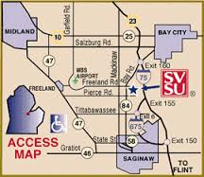
Saginaw Valley State University
Location: 6 miles from downtown Saginaw in Kochville Township, Saginaw County
Address: 7400 Bay Rd, University Center, MI 48604

Slide 3
Campus

Slide 4
Campus

Slide 5
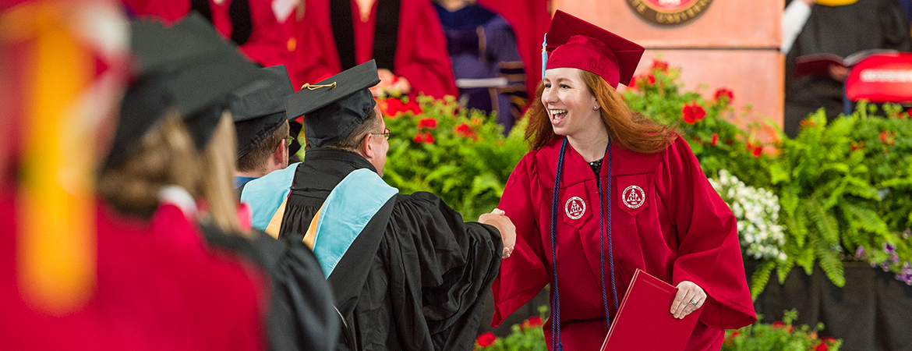
Graduation rate
Percentage: 39.7%

Slide 6
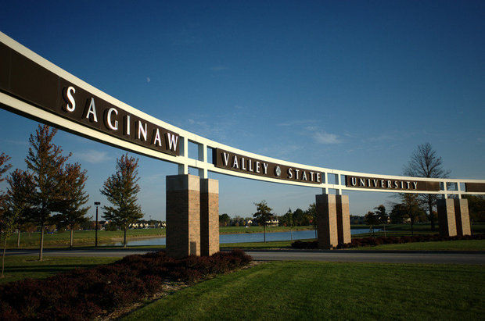
Number of students
Undergraduates: 8,763
Graduates: 1,003

Slide 7
How many students apply?
Students who apply: 6,266
Students who were admitted: 5,010
Students who enroll: 1,507

Slide 8
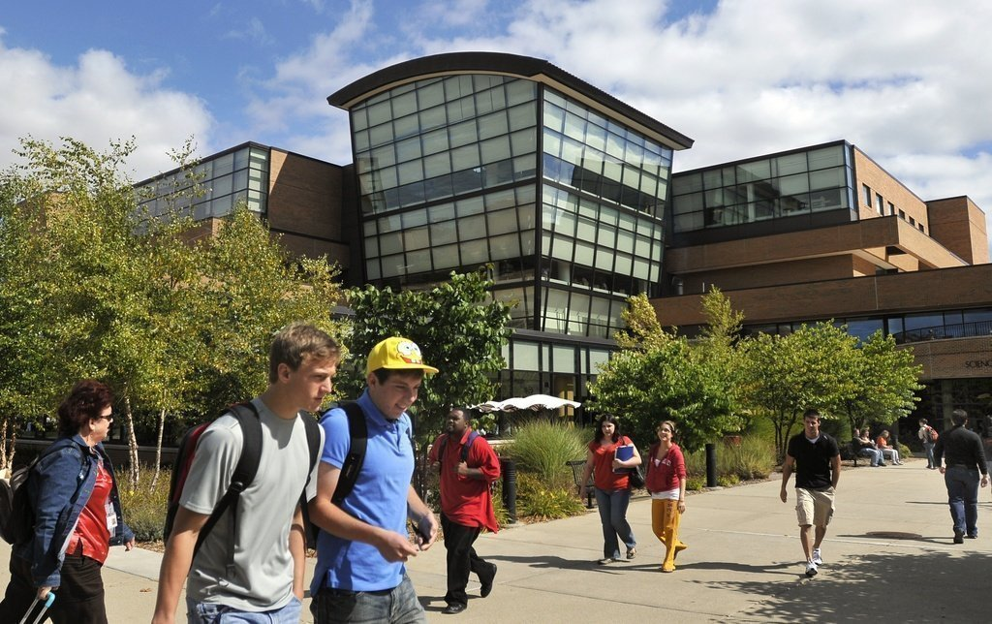
Class size
Average class size: 24

Slide 9
Requirements for the Honors Program
Minimum 3.70 cumulative high school GPA
Minimum 28 ACT composite score
1310 SAT composite score (new test)/1880 (old test)
OR Be ranked #1 or #2 in your high school graduating class & a minimum 24 ACT composite score

Slide 10
Freshman Academic Profile
GPA
HS Class Rank
ACT Score
Average: 3.35
30% 3.75+
17% 3.5 - 3.74
15% 3.25 - 3.49
14% 3.00 - 3.24
19% 2.50 - 2.99
5% 2.00 - 2.49
Top Tenth 2%
Top Quarter 7%
Top Half 26%
Bottom Half 74%
Bottom Quarter 42%
30 – 36 4%
24 – 29 33%
18 – 23 53%
12 – 17 6%
11 – 12 <1%

Slide 11
2015-2016 Annual Costs
Tuition/fees: $8,371
Books and Supplies: $1,250
Room and Board: $8,917
Personal expenses: $1,114

Slide 12
2015-2016 Financial Aid
Need Based Financial Aid
91% Applied
71% Offered
Average 1st year financial aid package: $7,830
Average scholarships and grants: $11,200
Average Student Debt (after 4 years) = $23,500 - $30,000

Slide 13
Most Popular Majors
Elementary Education and Teaching
Health/Medical Preparatory Programs
Registered Nursing/Registered Nurse
Social Work
Criminal Justice/Safety Studies

Slide 14
Unique Facts!
While the number one priority for students is their academic experience, more than 130 Registered Student Organizations enrich and enhance their extracurriculuar and college experience. Ex: Battle of the Valleys is a fund-raising competition between SVSU and intra-state rival Grand Valley State University. In 2014, SVSU raised $32,294 for the Cory Rivard Jr. Promise Foundation!

Slide 15
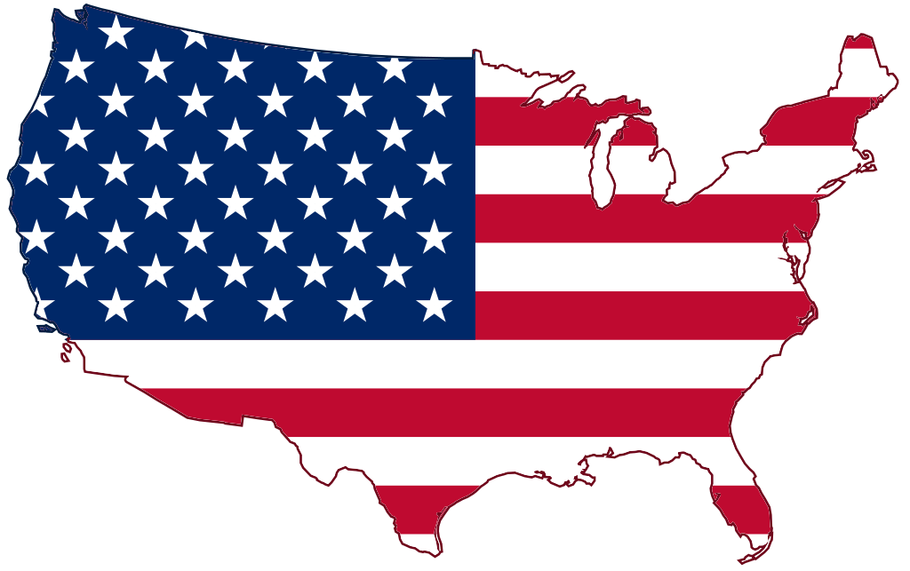
Unique Facts!
They have alumni in all 50 states!
Top 5 states with SVSU alumni are Michigan, Florida, Texas, Ohio and California.

