Slide 1
Literary Analysis Vocabulary
Definitions (You will be quizzed on these!)

Slide 2
The repetition of the same or similar consonant sounds in words that are close together. Ex: but the sea, the sea in the darkness calls.
ALLITERATION

Slide 3
A REFERENCE IN A WORK OF LITERATURE TO A WELL-KNOWN PERSON, PLACE, EVENT, WRITTEN WORK, OR WORK OF ART
ALLUSION

Slide 4
A COMPARISON MADE BETWEEN TWO THINGS TO SHOW HOW THEY ARE ALIKE. Ex: a thief breaking into a house is like a king interfering in affairs of American colonies.
ANALOGY

Slide 5
a short account of a particular incident or event, especially of an interesting or amusing nature.
ANECDOTE

Slide 6
A PERSON OR FORCE THAT OPPOSES THE PROTAGONIST IN A STORY
ANTAGONIST

Slide 7
A form of persuasion that appeals to reason, rather than emotion, to convince an audience to think or act a certain way.
ARGUMENT

Slide 8
THE GENERAL MOOD, OR EMOTIONAL QUALITY, OF A LITERARY WORK
ATMOSPHERE

Slide 9
An individual in a story or play.
CHARACTER

Slide 10
THE AUTHOR DESCRIBES A CHARACTER’S PERSONALITY (Very straightforward)
DIRECT CHARACTERIZATION

Slide 11
THE AUTHOR SUGGESTS TRAITS THROUGH A CHARACTER’S WORDS, ACTIONS, OR APPEARANCE, AS WELL AS THROUGH THE REACTIONS OF OTHER CHARACTERS TO THE PERSON BEING PORTRAYED.
INDIRECT CHARACTERIZATION

Slide 12
A literary character who undergoes little or no inner change
STATIC CHARACTER

Slide 13
GROWS OR CHANGES SIGNIFICANTLY DURING THE COURSE OF THE STORY. THIS TYPE OF CHARACTER IS INFLUENCED BY HIS OR HER EXPERIENCES AND BY THE OTHER CHARACTERS IN THE STORY.
DYNAMIC CHARACTER

Slide 14
CHARACTERS WHO REVEAL ONLY ONE PERSONALITY TRAIT.
FLAT CHARACTERS

Slide 15
Characters who show varied and sometimes contradictory traits.
ROUND CHARACTERS

Slide 16
THE EMOTIONAL HIGH POINT
CLIMAX

Slide 17
Problems that arise when characters try to solve their conflict
COMPLICATION

Slide 18
THE CENTRAL STRUGGLE BETWEEN TWO OPPOSING FORCES IN A STORY
CONFLICT

Slide 19
A STRUGGLE THAT TAKES PLACE WITHIN THE MIND OF A CHARACTER WHO IS TORN BETWEEN OPPOSING FEELINGS OR GOALS
INTERNAL CONFLICT

Slide 20
EXISTS WHEN A CHARACTER STRUGGLES AGAINST SOME OUTSIDE FORCE, SUCH AS ANOTHER PERSON, NATURE, SOCIETY, OR FATE
EXTERNAL CONFLICT

Slide 21
The conclusion, or resolution, of a story
DENOUEMENT

Slide 22
The author’s choice of words in regard to vocabulary, slang, language, and level of formality
DICTION

Slide 23
THE INTRODUCTION OF THE CHARACTERS, THE SETTING, AND THE CONFLICT
EXPOSITION

Slide 24
Also Called Figure of SpeecH: LANGUAGE THAT IS NOT MEANT TO BE INTERPRETED LITERALLY, AND IS USED FOR DESCRIPTIVE EFFECT, OFTEN TO IMPLY IDEAS INDIRECTLY.
FIGURATIVE LANGUAGE

Slide 25
A NARRATIVE PASSAGE SET IN A EARLIER TIME THAT INTERRUPTS THE CHRONOLOGICAL ORDER OF THE REST OF THE STORY.
FLASHBACK

Slide 26
A character who acts as a contrast to another character. EX: Dr. Jekyll and Mr. Hyde.
FOIL

Slide 27
A HINT OR CLUE OF AN EVENT TO OCCUR LATER IN THE PLOT
FORESHADOWING

Slide 28
exaggerated statements or claims not meant to be taken literally.
HYPERBOLE

Slide 29
to use figurative language to represent objects, actions and ideas in such a way that it appeals to our physical senses
IMAGERY

Slide 30
A CONTRAST OR DISCREPANCY BETWEEN EXPECTATION AND REALITY
IRONY

Slide 31
EXISTS WHEN A PERSON SAYS ONE THING WHILE MEANING ANOTHER
VERBAL IRONY

Slide 32
EXISTS WHEN THE OUTCOME OF A SITUATION IS THE OPPOSITE OF WHAT SOMEONE EXPECTED.
SITUATIONAL IRONY

Slide 33
OCCURS WHEN THE AUDIENCE OR READER KNOWS SOMETHING THAT THE CHARACTERS DO NOT KNOW. Ex: romeo and Juliet
DRAMATIC IRONY

Slide 34
A mixture of personality and situation that drives a character to behave a certain way
MOTIVATION

Slide 35
Also called parallelism: the repetition of words or phrases that have similar grammatical structures. Ex: he went swimming, biking, and running.
PARALLEL STRUCTURE

Slide 36
THE SEQUENCE OF EVENTS IN A NARRATIVE WORK
PLOT

Slide 37
THE RELATIONSHIP OF THE NARRATOR TO THE STORY
POINT OF VIEW

Slide 38
THE NARRATOR IS A CHARACTER IN THE STORY, REFERRED TO AS “I”
FIRST-PERSON POINT OF VIEW

Slide 39
THE NARRATOR REVEALS THOUGHTS, FEELINGS, AND OBSERVATIONS OF ONLY ONE CHARACTER, REFERRING TO THAT CHARACTER AS “HE” OR “She.”
THIRD-PERSON LIMITED POINT OF VIEW

Slide 40
ALL-KNOWING POINT OF VIEW, THE NARRATOR IS NOT A CHARACTER IN THE STORY, BUT SOMEONE WHO STANDS OUTSIDE THE STORY AND COMMENTS ON THE ACTION
THIRD-PERSON OMNISCIENT POINT OF VIEW

Slide 41
A narrator who is totally impersonal and does not give personal comments on the characters or events.
OBJECTIVE POINT OF VIEW

Slide 42
THE CENTRAL CHARACTER IN A STORY AROUND WHOM MOST OF THE ACTION REVOLVES.
PROTAGONIST

Slide 43
SOMETIMES CALLED THE DENOUEMENT, IN WHICH THE FINAL OUTCOME IS REVEALED
RESOLUTION

Slide 44
A question asked for effect, not actually requiring an answer.
RHETORICAL QUESTION

Slide 45
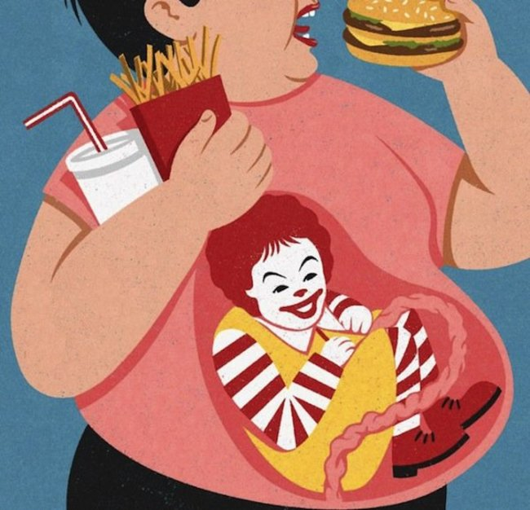
A type of writing that ridicules the shortcomings of people or institutions in an attempt to bring about change.
SATIRE

Slide 46
THE TIME AND PLACE IN WHICH THE EVENTS OF A LITERARY WORK OCCUR.
SETTING

Slide 47
THE EXPRESSIVE QUALITIES THAT DISTINGUISH AN AUTHOR’S WORK (WORD CHOICE, SENTENCE STRUCTURE, AND FIGURES OF SPEECH)
STYLE

Slide 48
OBJECTS THAT REPRESENT A DEEPER MEANING OR SOMETHING LARGER THAN THE OBJECT ITSELF.
SYMBOL

Slide 49
THE MAIN IDEA OF A STORY, SOMETIMES EXPRESSED AS A STATEMENT ABOUT LIFE
THEME

Slide 50
Not to be confused with MOOD A REFLECTION OF THE WRITER’S ATTITUDE TOWARD A SUBJECT USING WORD CHOICE, PUNCTUATION, SENTENCE STRUCTURE, AND FIGURES OF SPEECH
TONE

Slide 51
the presentation of something as being smaller, worse, or less important than it actually is
UNDERSTATEMENT

